Slide 1


Chih-Yun Lu (Belle) | Sam Zierler | Jingxuan Xiao (Matt)
2022 CUSP Capstone | Summer Progress Update
Informing Policymakers on State Level Supplemental Security Income Support

Slide 2

Contents
Identification of Policy Implications
SSI Program Eligibility
Literature Review
Problem Definition
Data Engineering
Case Study & Tableau
Method & Model
Visualization

Slide 3

Identification of Policy Implications

Slide 4
SSI Program Eligibility
65 years old or older
Limited resources
Blind
SSI
Limited income
Disabled

Slide 5
Literature Review
Title: When One Size Does Not Fit All: Modernizing the Supplemental Security Income Program by Mary C. Daly, Mark Duggan
Date: First Published November 6, 2019
Place of publication: American Academy of Political & Social Science (AAPSS)
Title: Improving the Supplemental Security Income Program for Adults with Disabilities by Jack Smalligan, Chantel Boyens
Date: April 2019
Place of publication: Urban Institute
Title: The Supplemental Security Income Program by Mark Duggan, Melissa S. Kearney & Stephanie Rennane
Date: November 2016
Place of publication: National Bureau of Economic Research

Slide 6
Problem Definition
Couple penalty
single
couple

Slide 7
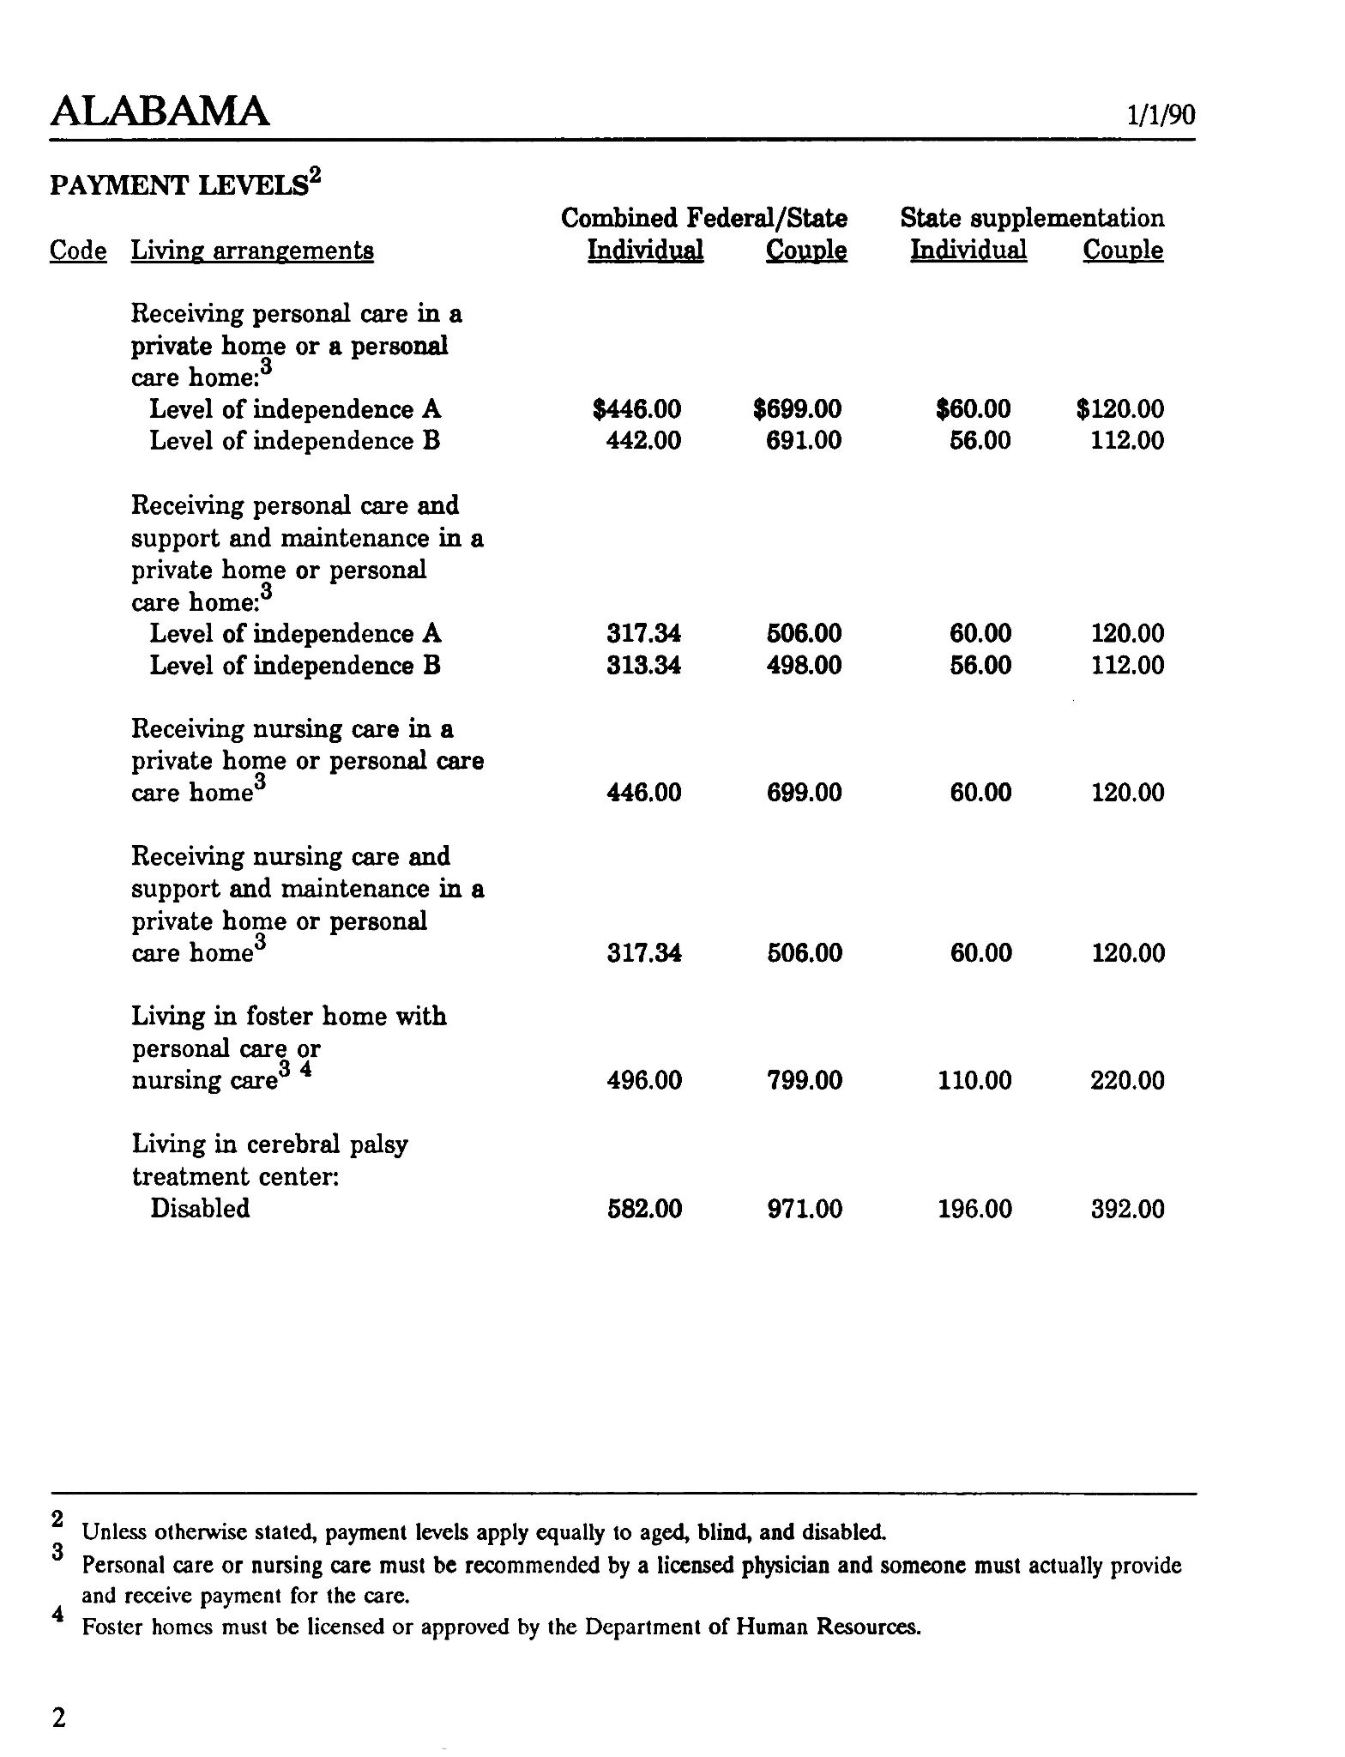
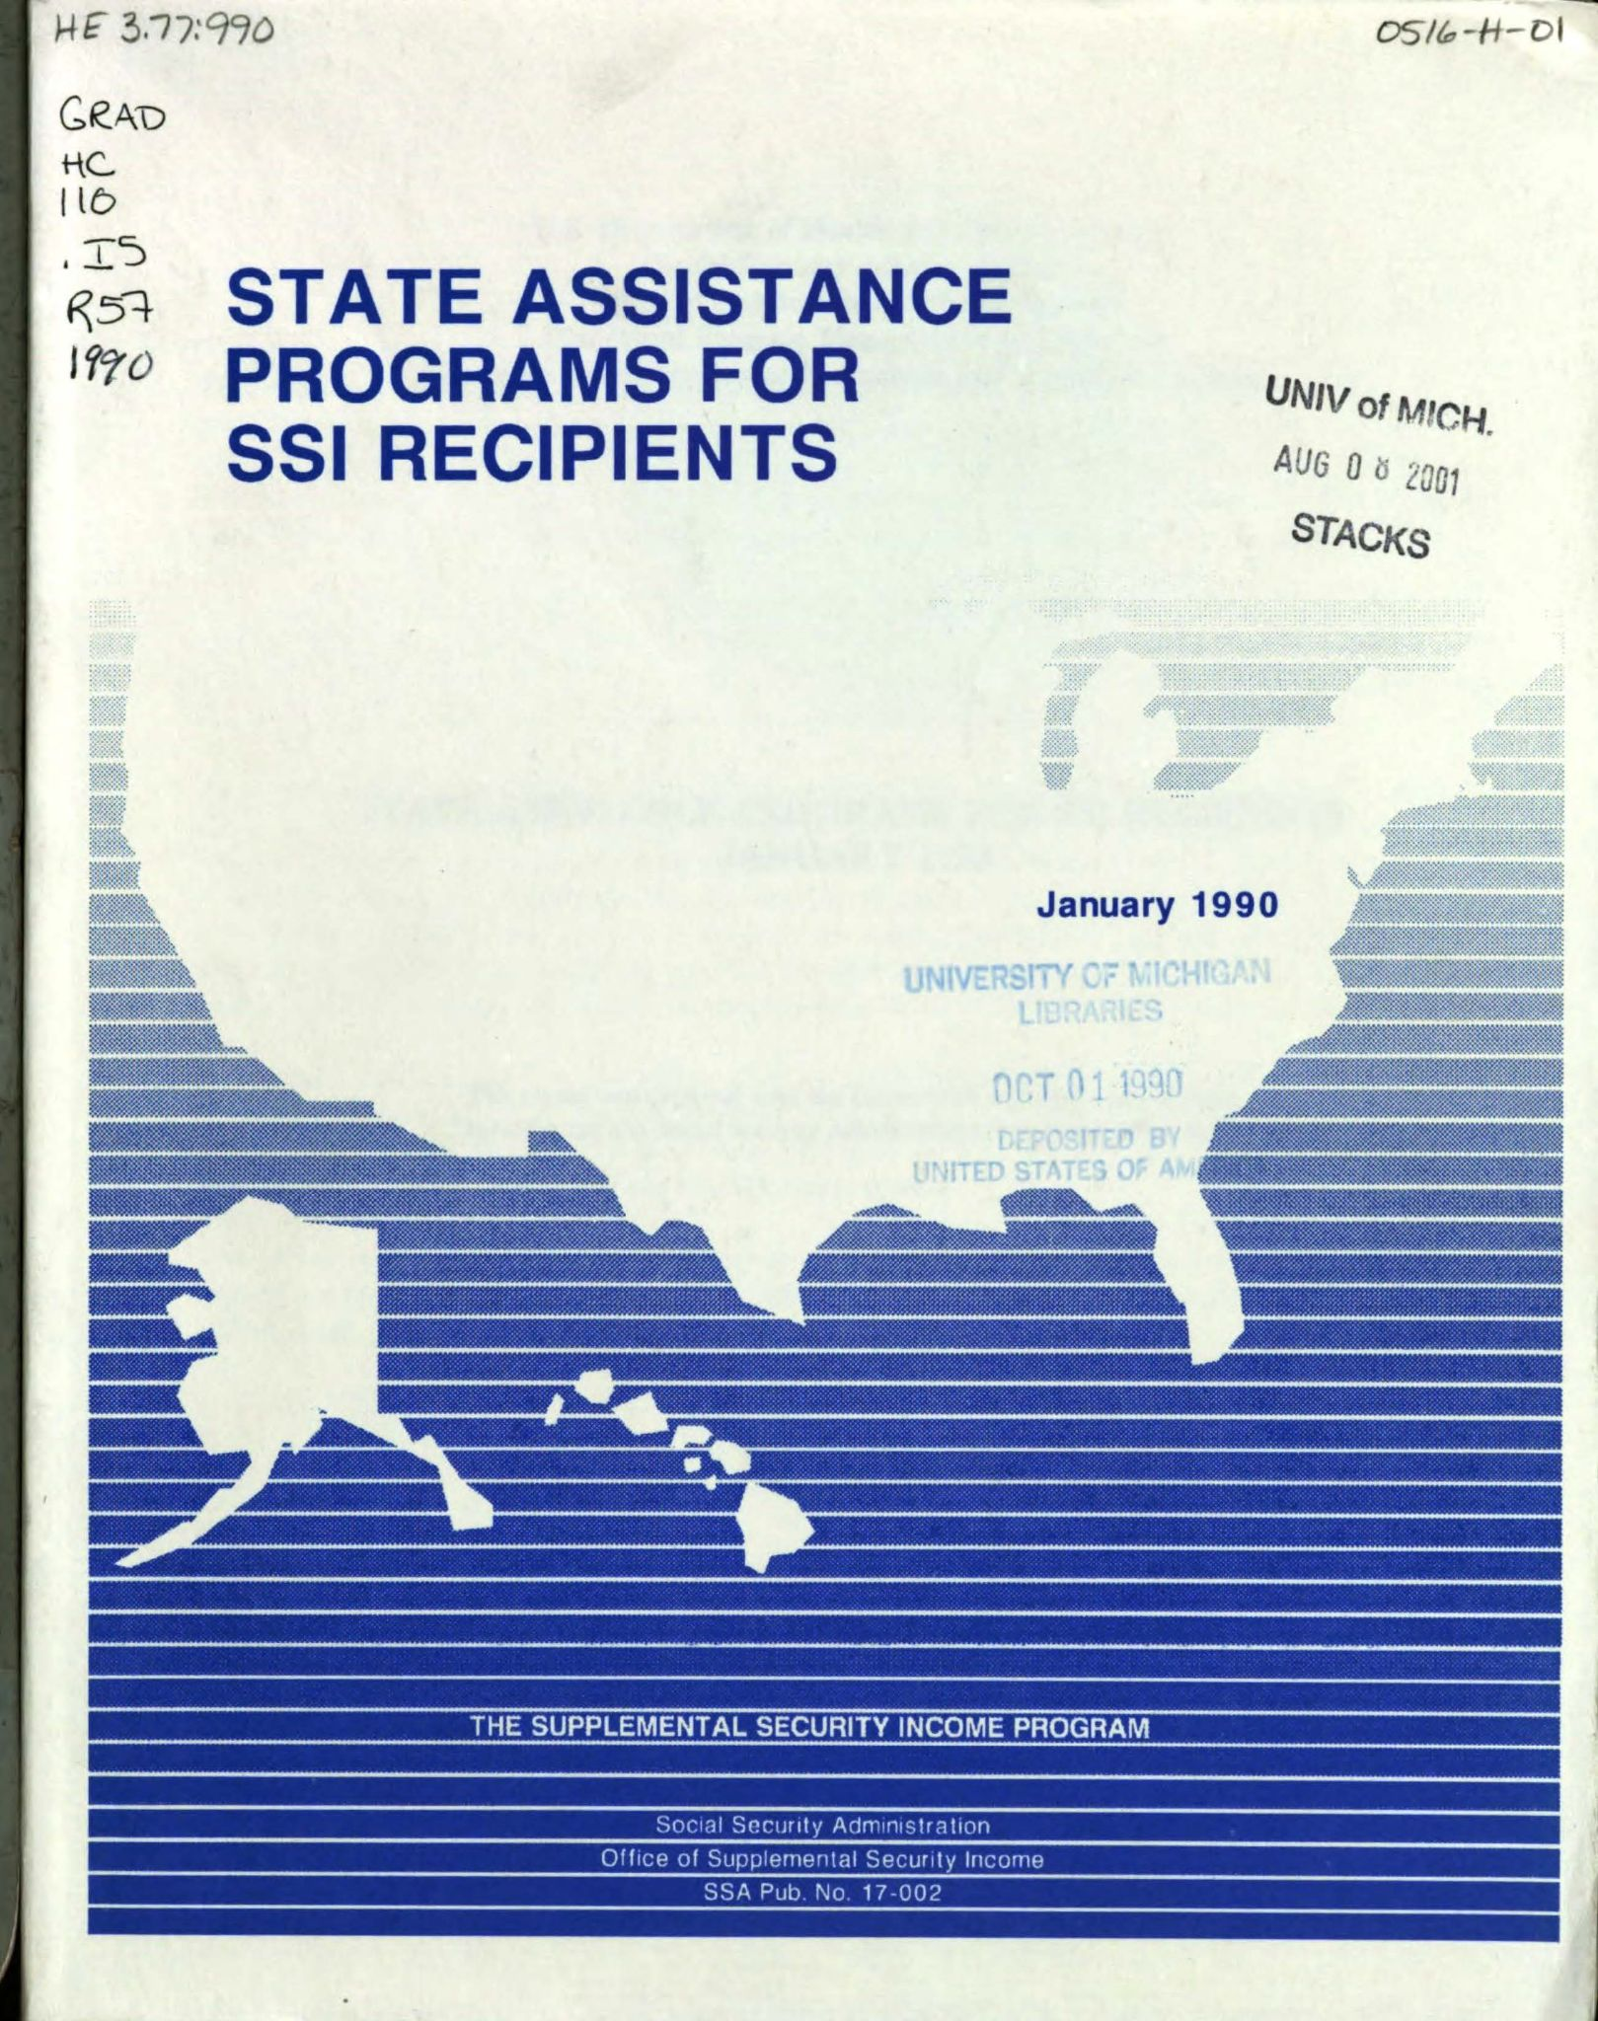
Primary Data

Slide 8
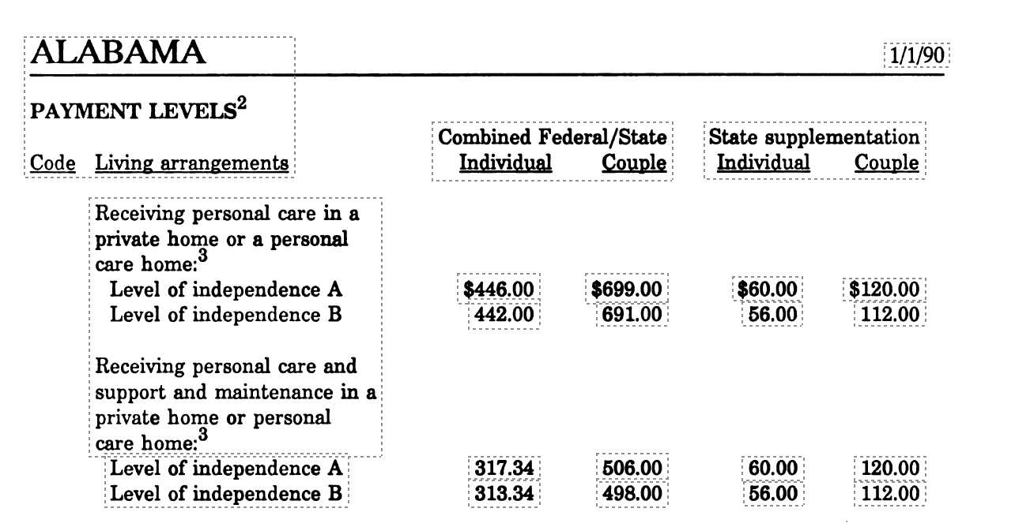
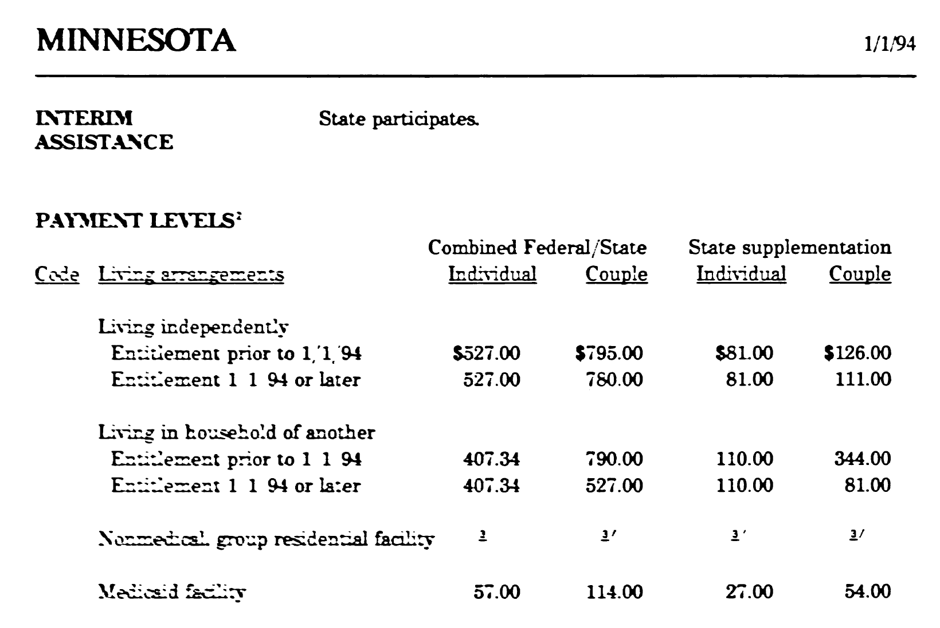
Complications

Slide 9
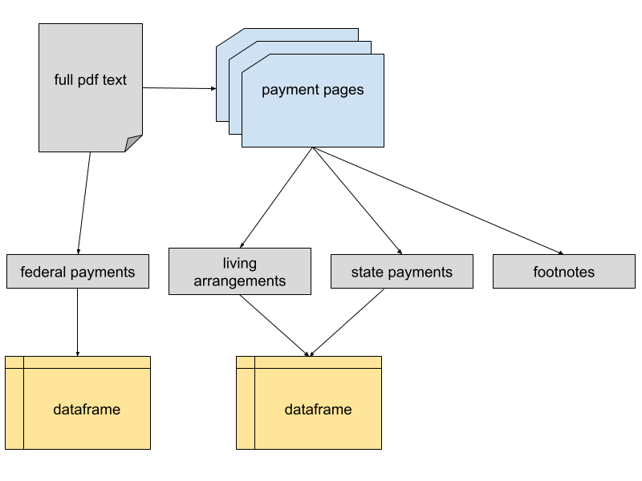
Data Extraction Pipeline

Slide 10
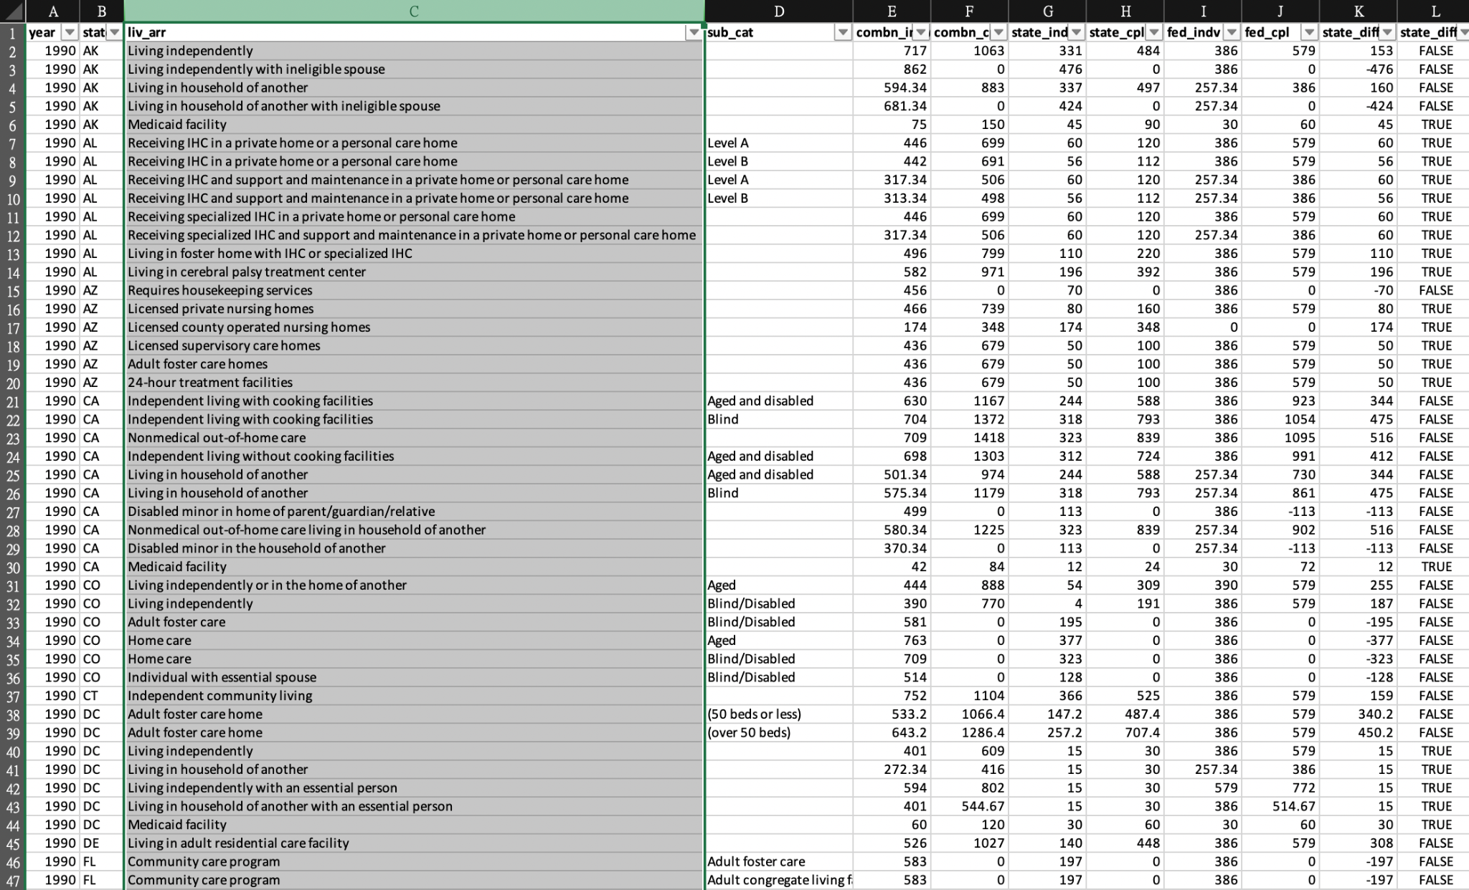
Final Data Output

Slide 11
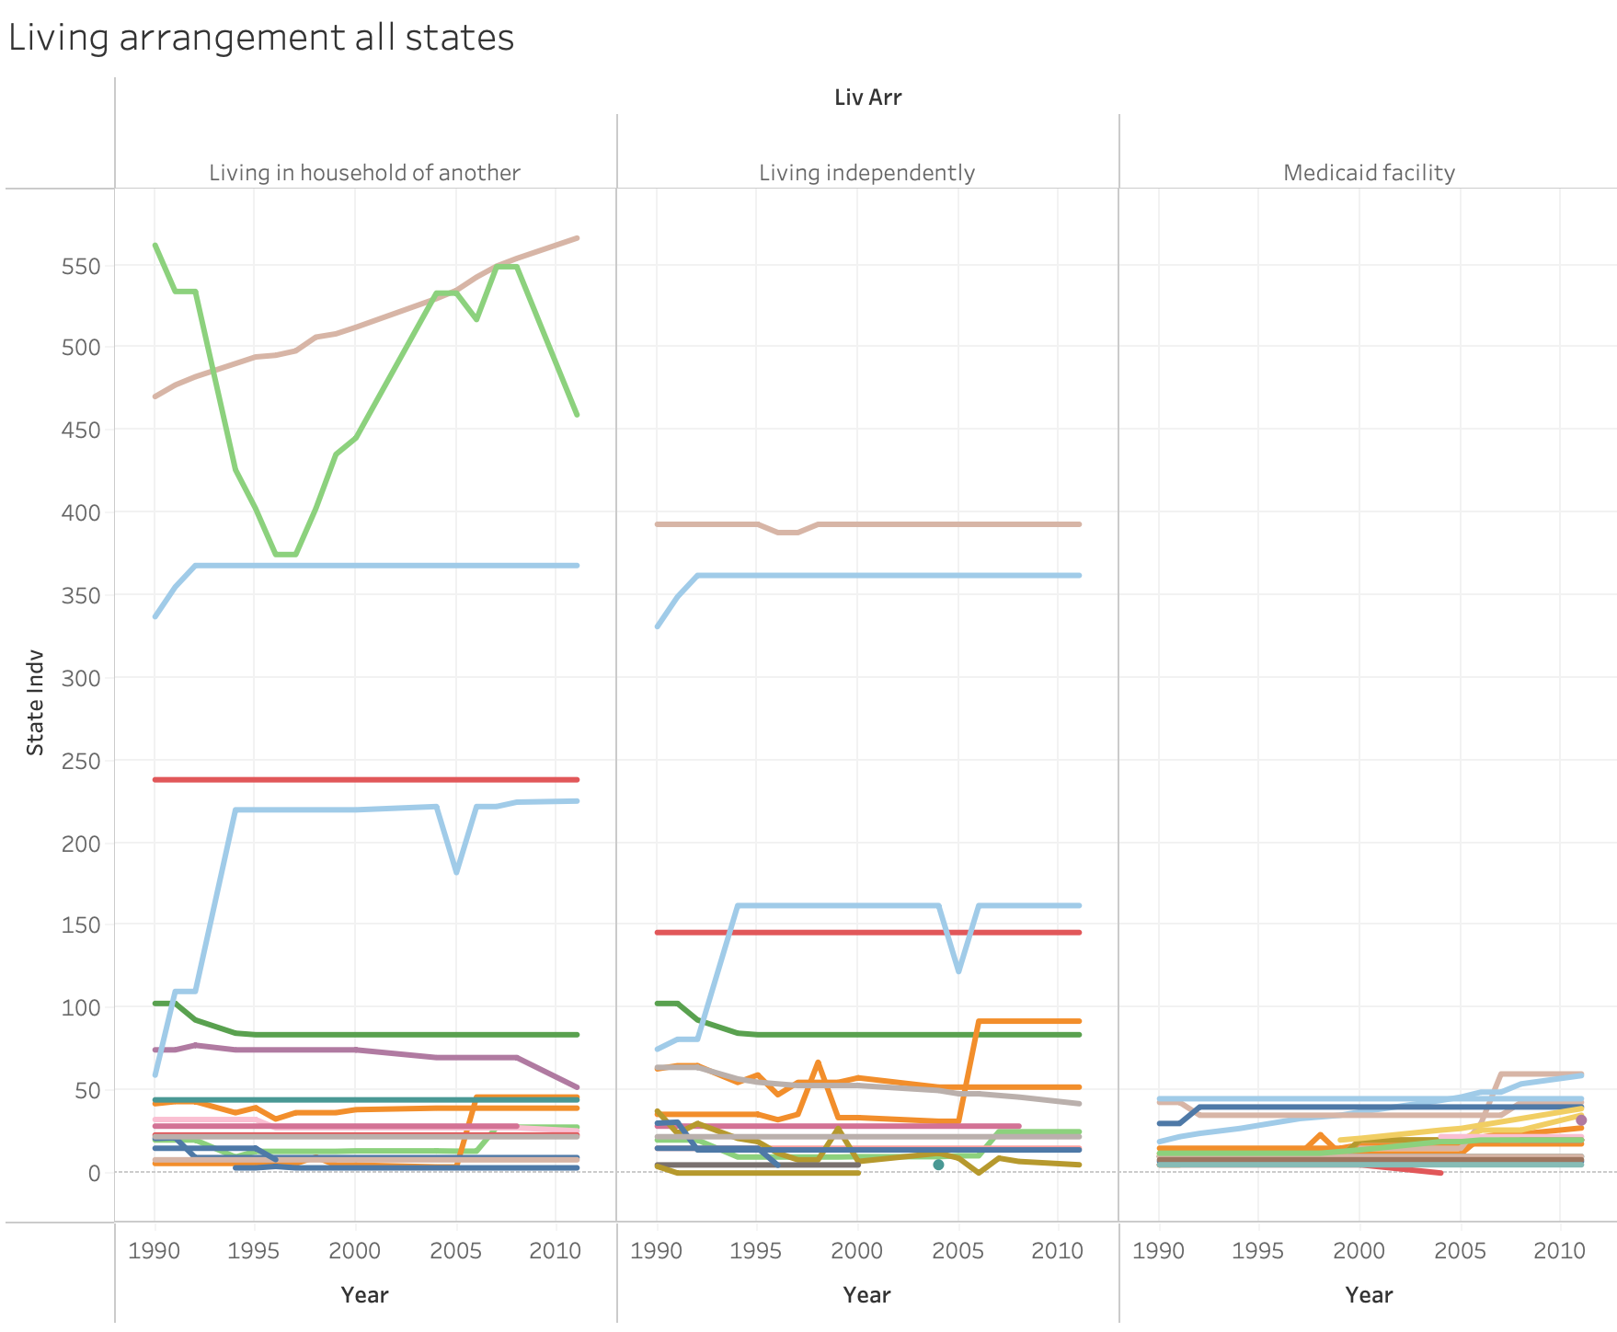
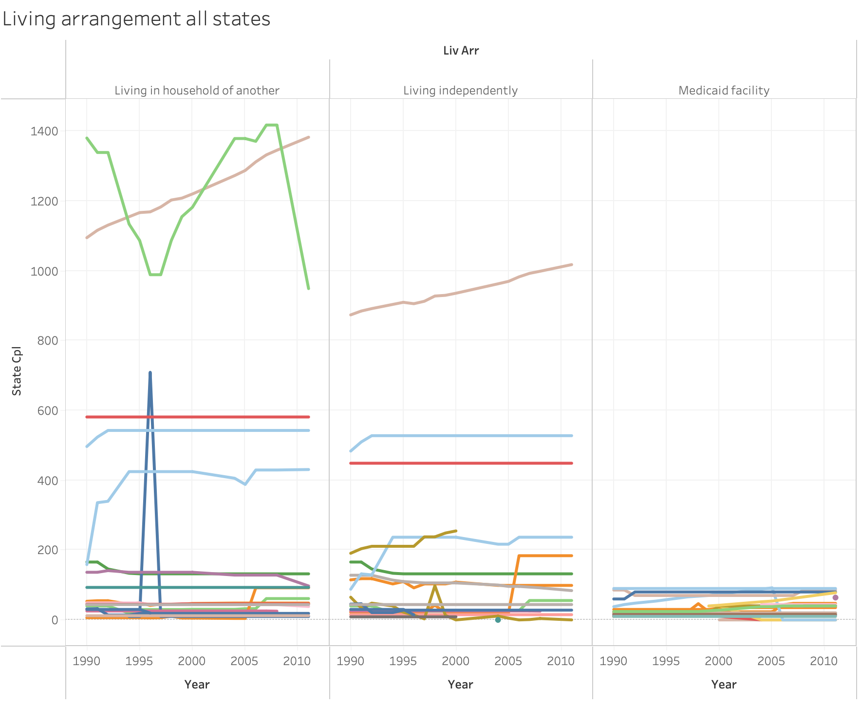
Case Study & Tableau
133 kinds of living arrangements
Living in household of another
Living independently
Medicaid facility

Slide 12
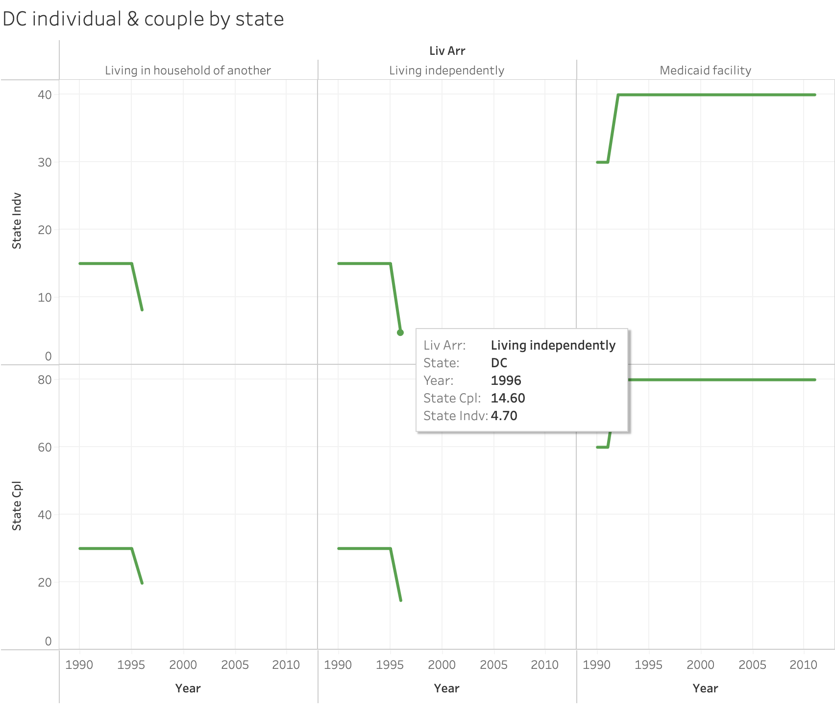
Case Study & Tableau
Washington, D.C. by state

Slide 13
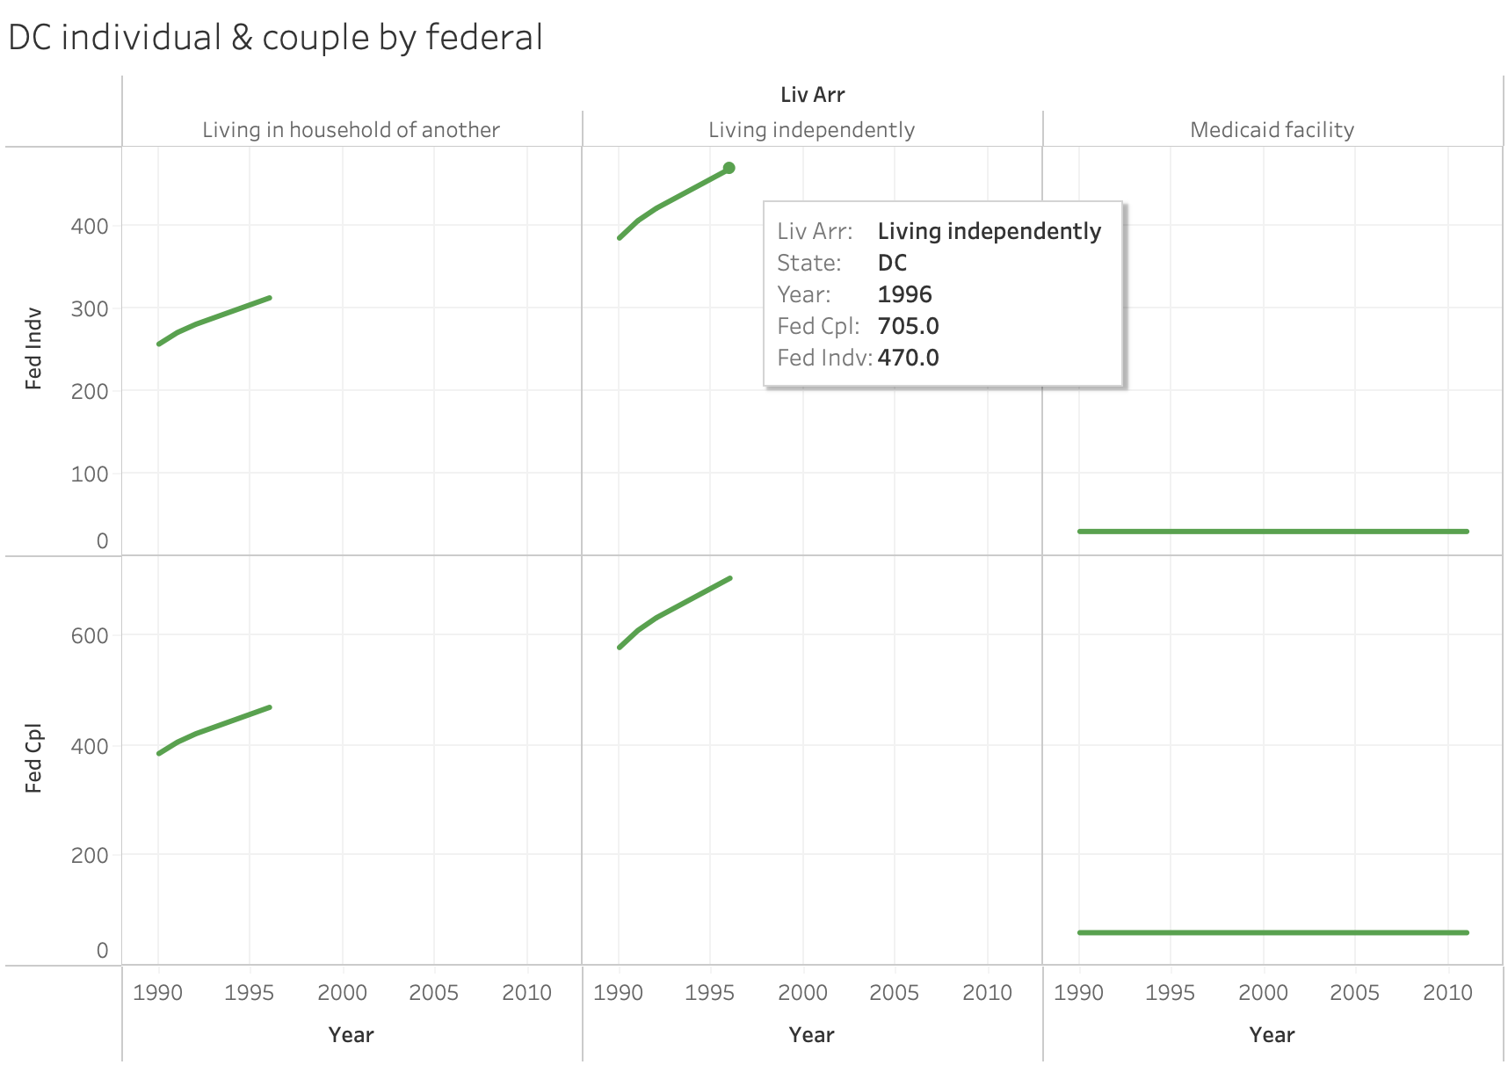
Case Study & Tableau
Washington, D.C. by federal

Slide 14
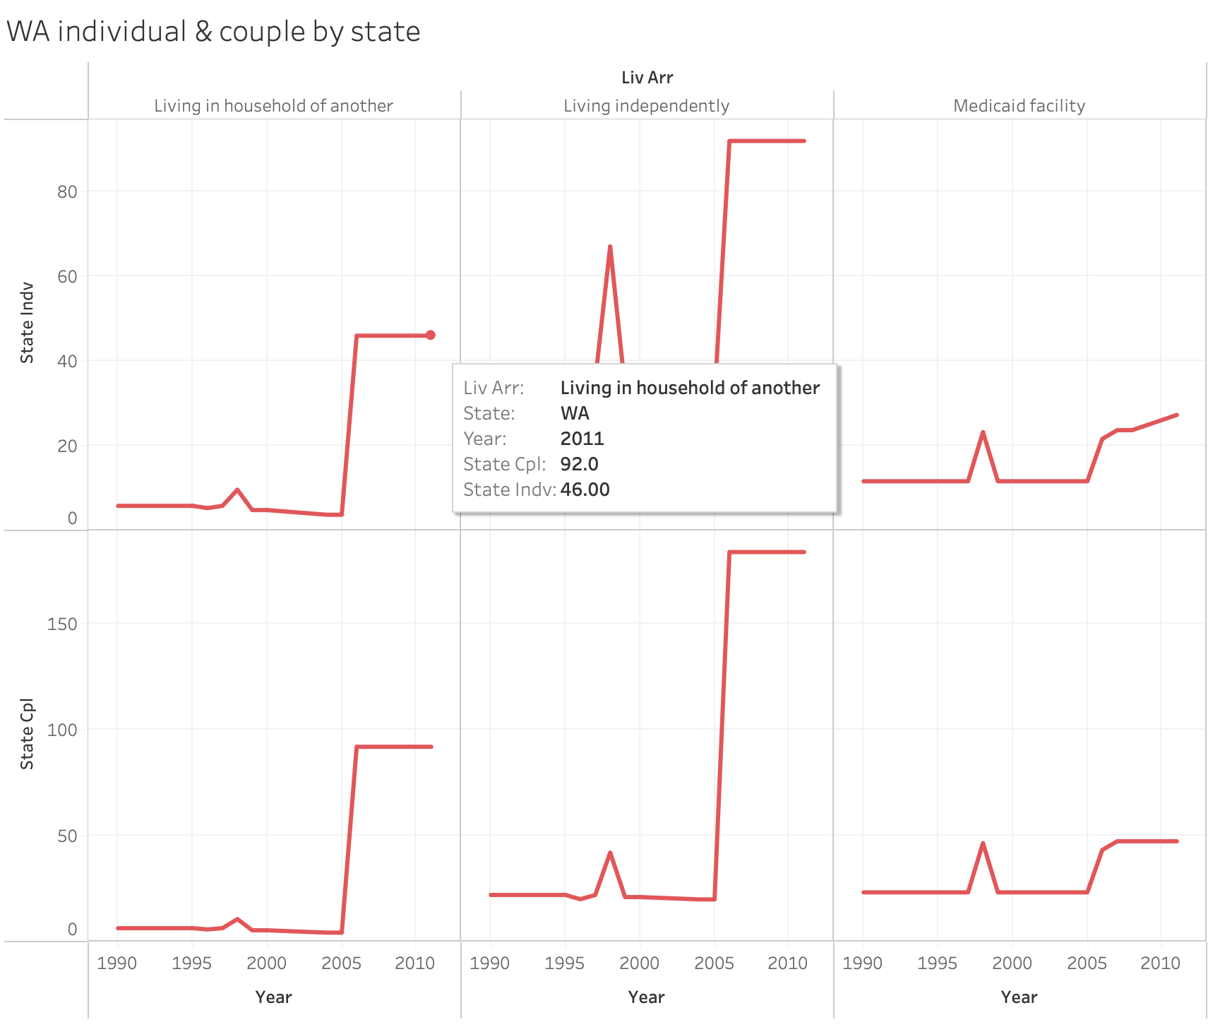
Case Study & Tableau
Washington by state

Slide 15
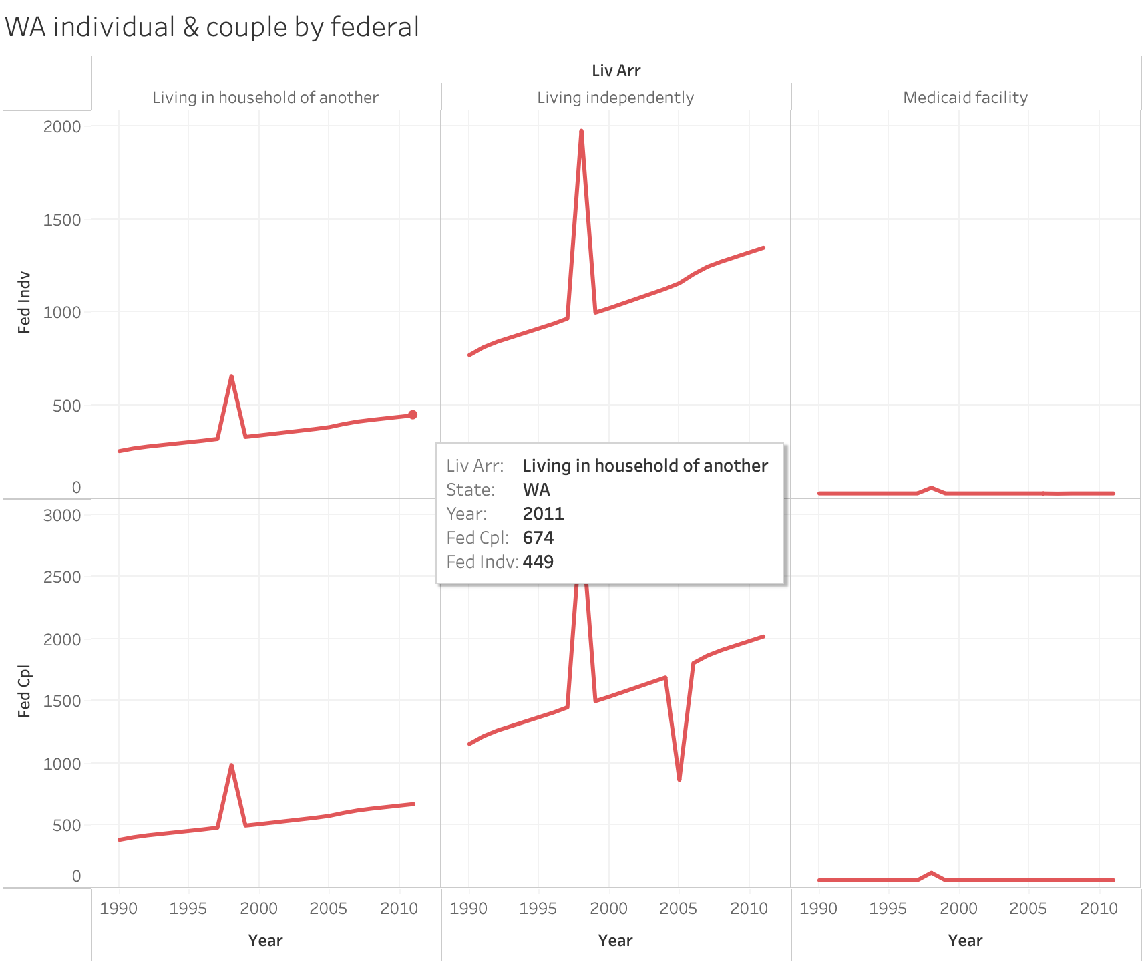
Case Study & Tableau
Washington by federal

Slide 16
Method & Model
ARIMA

Slide 17
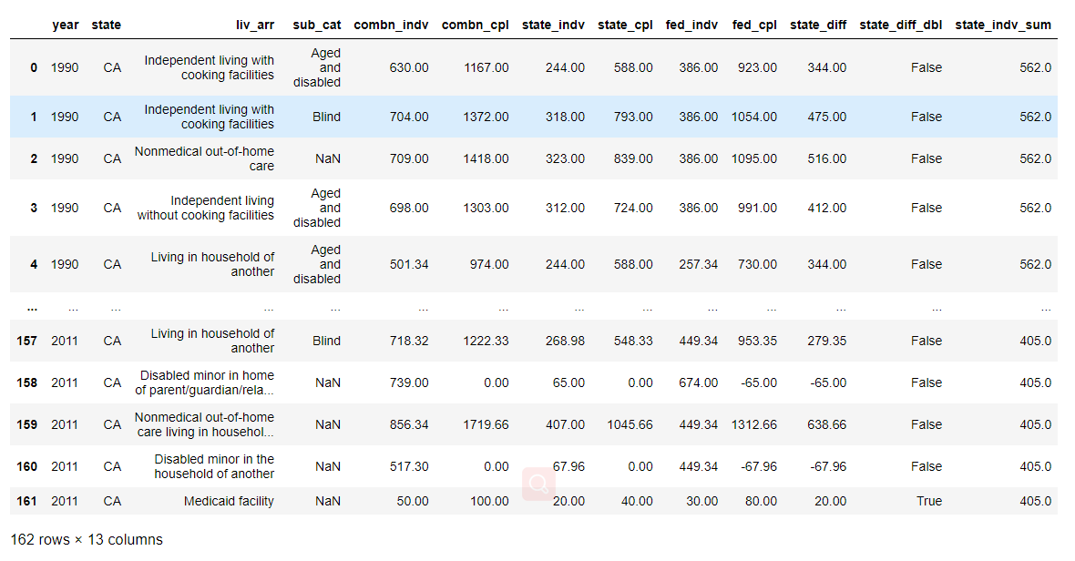
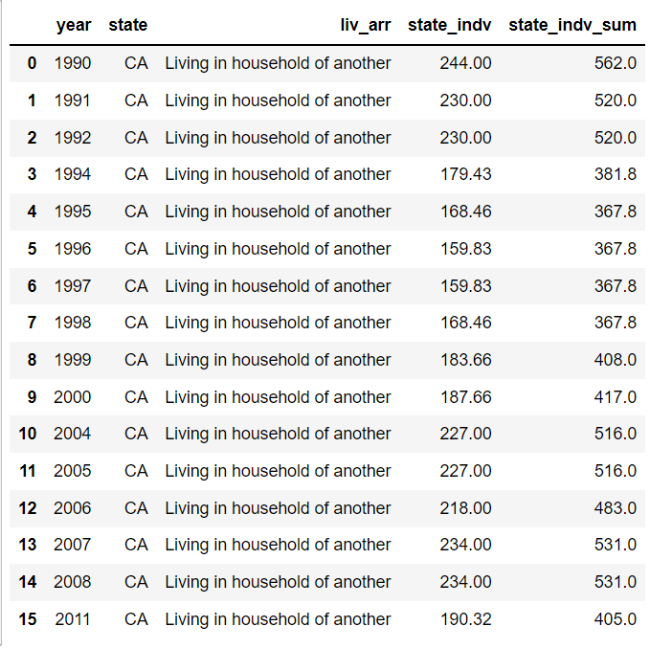
ARIMA Model
Step 1: Data preprocessing and make decisions to choose what specified data to analyze.

Slide 18
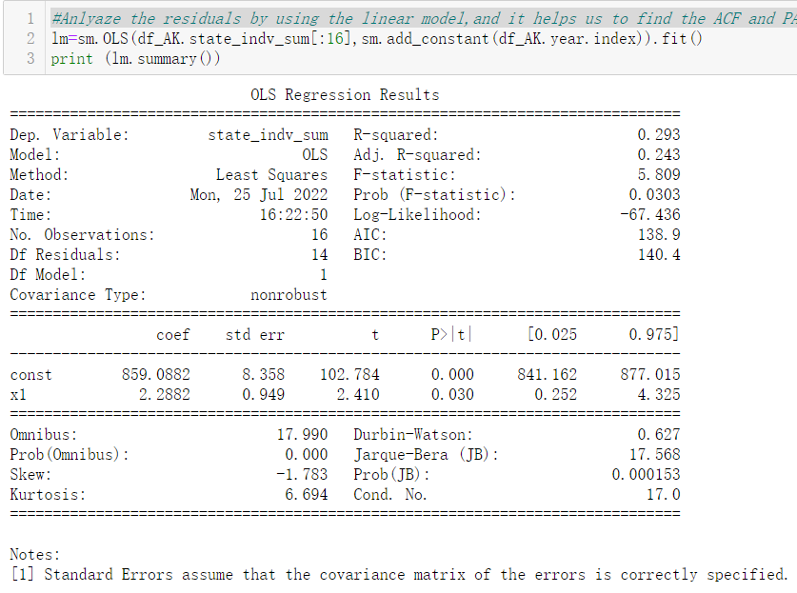
Step 2: Analyze the residuals by using the linear model, since it helps us to find the Auto-Regressive and Moving Average in the series data，and they are the moving-average “signature” belonged to ARIMA terms.

Slide 19
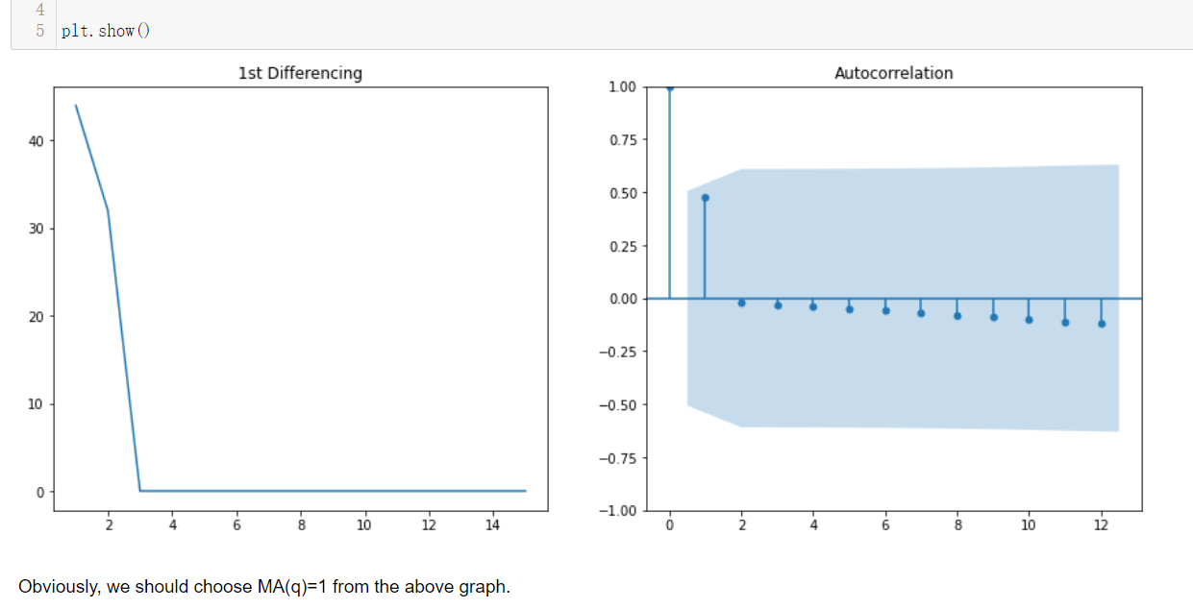
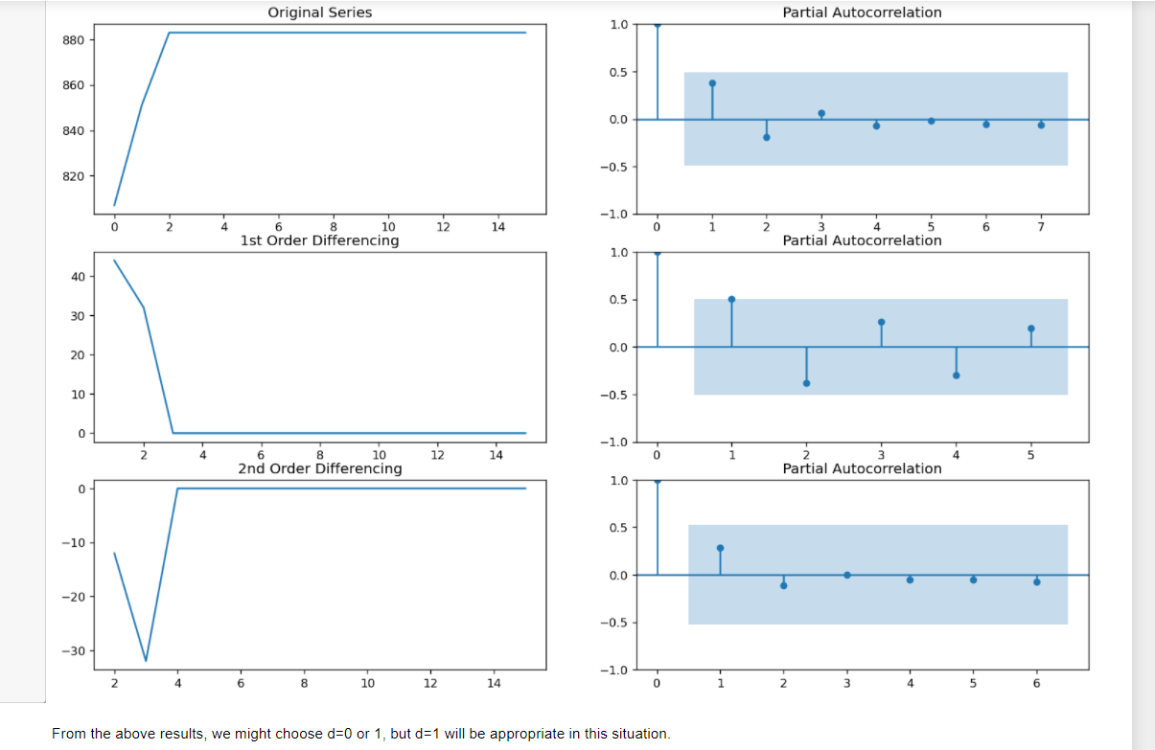
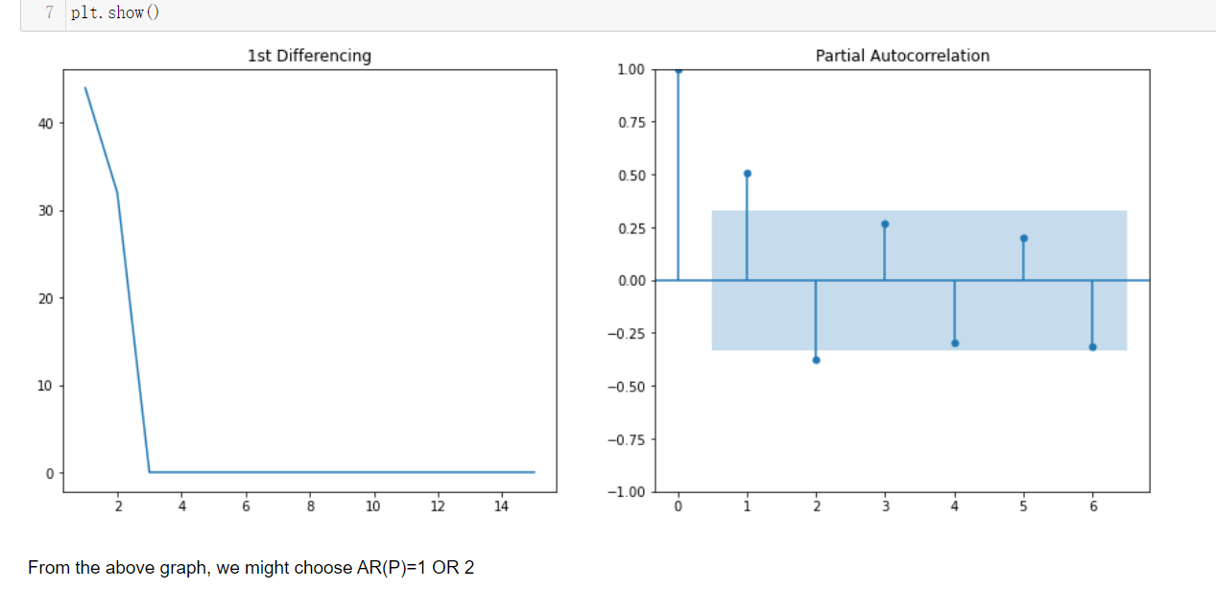
Step 3: Choosing the parameters for the ARIMA Model(MA, AR and d)

Slide 20
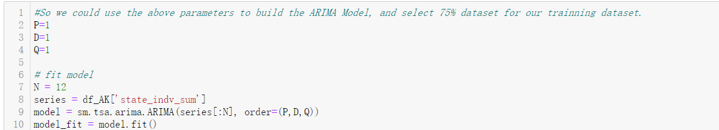
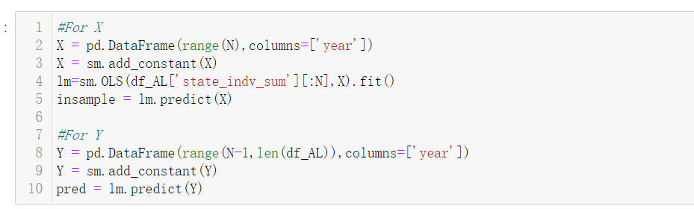
Step 4: Build the model with chosen parameters and train the model with training dataset

Slide 21
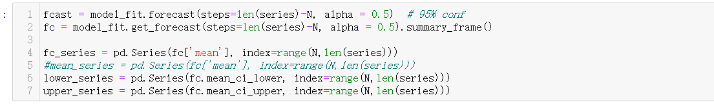
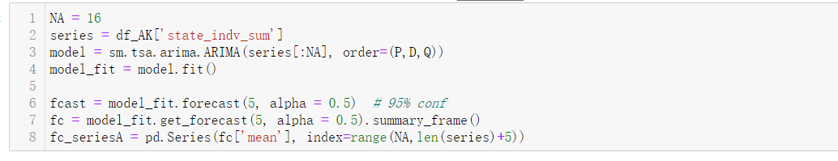
Step 5: Plot the ARIMA Model line with predicted values
Step 6: Predict the out-of-sample and plot the ‘future’ results from 2011 to 2016

Slide 22
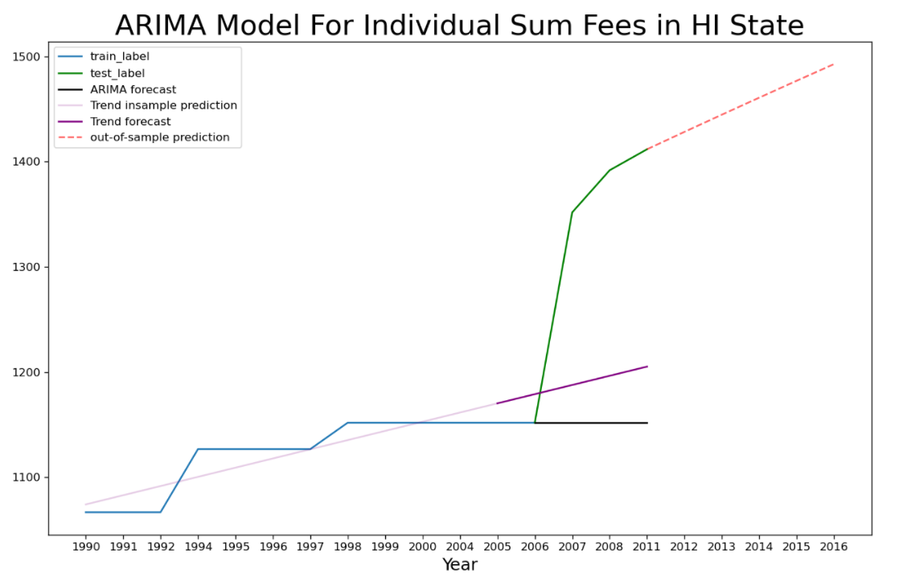
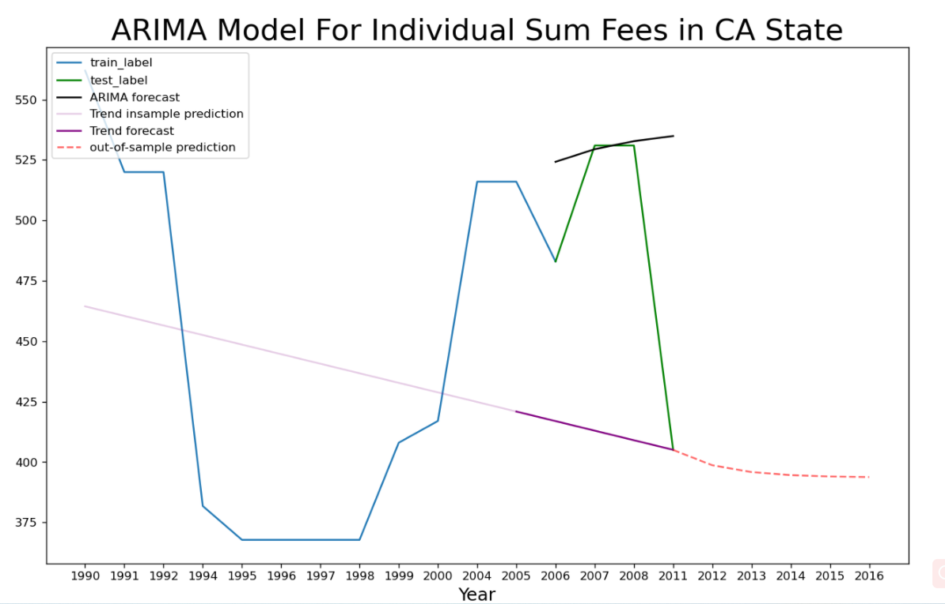
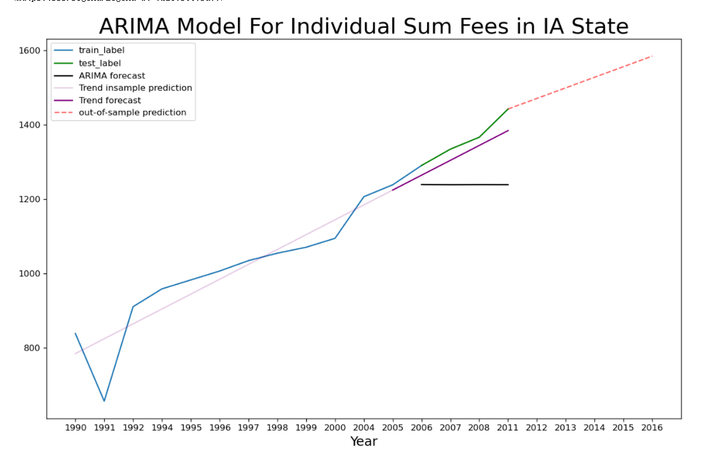
Step 7: Plot the final graph based on the above steps:

Slide 23
Visualization Tool
https://public.tableau.com/shared/73FZRDZZM?:display_count=n&:origin=viz_share_link

